Slide 1


“Information Security”
Lecture # 10
Dr. Engr. M Malook Rind
Ph.D (I.T), ME (CSN), MBA (MIS), BE (CS)
CCNA, CCNP, Juniper Certified.
Professor (Computer Science)

Slide 2

Contents
Network Security
Dr. M Malook Rind Information Security Lecture 10

Slide 3
Network Security
What is Network Security
Networking Threats, Assessments, and Defenses
Dr. M Malook Rind Information Security Lecture 10

Slide 4
What is Network Security
Network Security is a set of rules and configurations designed to protect the integrity, confidentiality and accessibility of computer networks and data using both software and hardware technologies.
Effective network security strategies employ multiple layers of defenses at the edge and in the network that are scalable and automated.
Each network security layer implements policies and controls.
Dr. M Malook Rind Information Security Lecture 10

Slide 5
Network Level Attacks and Countermeasures
A network attack is an attempt to gain unauthorized access to an organization’s network, with the objective of stealing data or perform other malicious activity.
Attackers use various attack strategies to compromise the security of a network, potentially causing disruption, damage, and loss to organizations and individuals.
Active network attacks seek to gain access to your network so that they can modify, encrypt, damage, or delete your data.
Passive network attacks try to gain access to your network stealthily and without raising an alarm.
Some of the common Network attacks include:
Sniffing Attacks
Distributed denial of service (DDoS) attacks
Session Hijacking
DNS Attacks
Dr. M Malook Rind Information Security Lecture 10

Slide 6
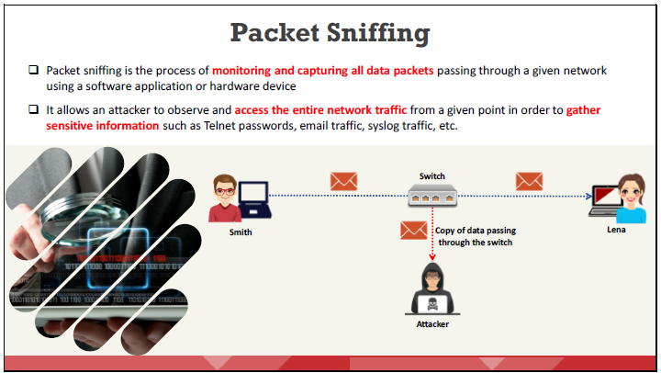
Network Level Attacks and Countermeasures - Sniffing Attacks
Sniffing is generally used by network administrators to perform network analysis, troubleshoot network issues, and monitor network sessions.
Attackers use sniffing techniques to covertly investigate and capture critical information such as passwords, account information, router configuration, DNS traffic, email traffic, web traffic, chat sessions, and FTP passwords being transmitted in a network.
Dr. M Malook Rind Information Security Lecture 10

Slide 7
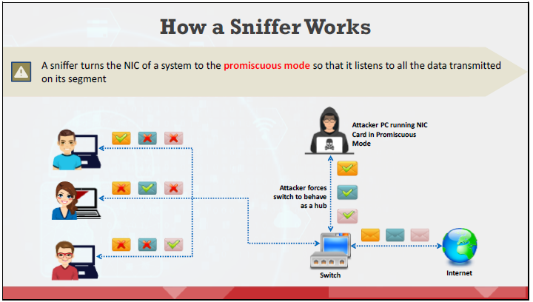
Network Level Attacks and Countermeasures - Sniffing Attacks
The most common way of networking computers is through an Ethernet connection. A packet sniffer placed on a network in promiscuous mode can therefore capture and analyze all the network traffic.
Promiscuous Mode allows a network device to intercept and read each network packet that arrives in its entirety. It is a mode of operation in which every data packet transmitted can be received and read by a network adapter.
Dr. M Malook Rind Information Security Lecture 10

Slide 8
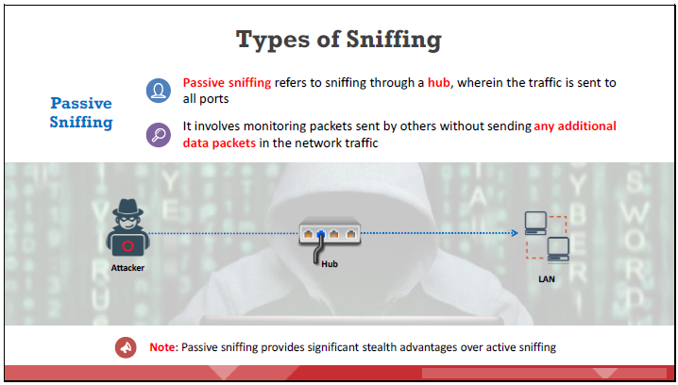
Network Level Attacks and Countermeasures - Sniffing Attacks
There are two types of sniffing. Each is used for different types of networks.
1. Passive Sniffing 2. Active Sniffing
It works only in a common collision domain i.e; the network that is not switched or bridged (i.e., connected through a hub). Common collision domains are present in hub environments.
In such networks, all hosts in the network can see all the traffic. A switch eliminates the risk of passive sniffing.
Dr. M Malook Rind Information Security Lecture 10

Slide 9
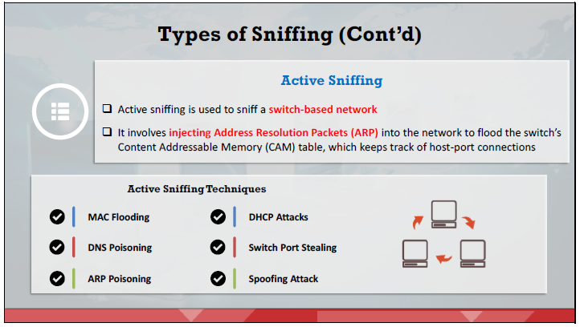
Network Level Attacks and Countermeasures - Sniffing Attacks
Active sniffing searches for traffic on a switched LAN by actively injecting traffic into it.
Dr. M Malook Rind Information Security Lecture 10

Slide 10
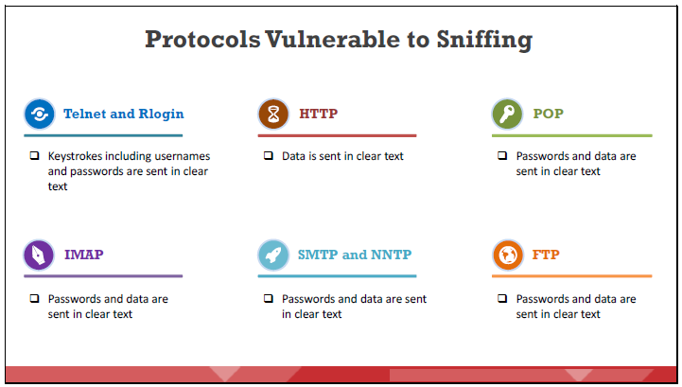
Network Level Attacks and Countermeasures - Sniffing Attacks
Following protocols are vulnerable to sniffing. The main reason for sniffing these protocols is to acquire passwords
Dr. M Malook Rind Information Security Lecture 10

Slide 11
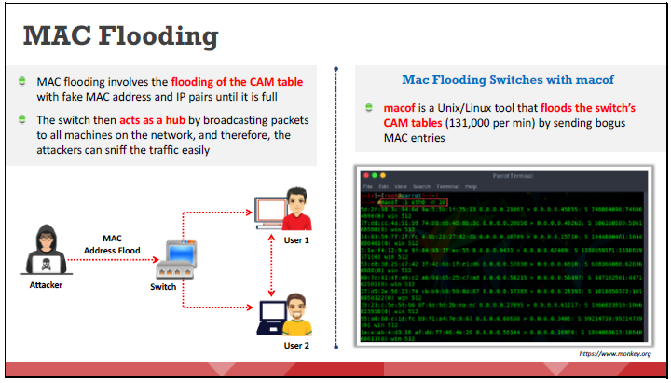
Network Level Attacks and Countermeasures - Sniffing Techniques
Attackers use various sniffing techniques, such as MAC attacks, DHCP attacks, ARP poisoning, spoofing attacks, and DNS poisoning, to steal and manipulate sensitive data.
Attackers use the MAC flooding technique to force the switch to enter fail-open mode and act as a hub so that they can easily sniff the traffic.
Dr. M Malook Rind Information Security Lecture 10

Slide 12
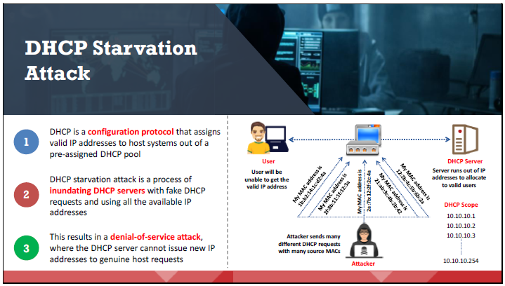
Network Level Attacks and Countermeasures - Sniffing Techniques
Dr. M Malook Rind Information Security Lecture 10

Slide 13
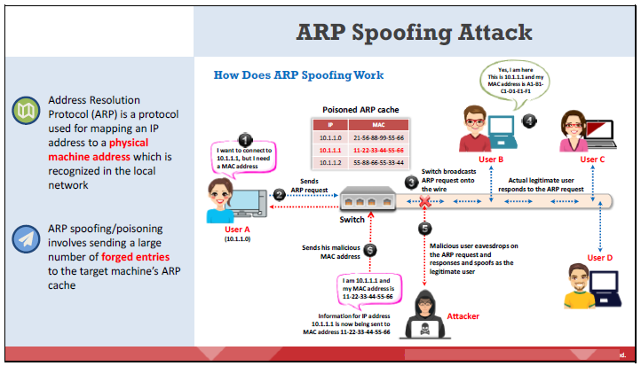
Network Level Attacks and Countermeasures - Sniffing Techniques
ARP provides no means of verifying the authenticity of the responding device.
Attackers use this flaw in ARP to create malformed ARP replies containing spoofed IP and MAC addresses.
Attackers flood a target computer’s ARP cache with forged entries; this is also known as poisoning. ARP spoofing is an intermediary for performing attacks such as DoS, MITM, and session hijacking
Dr. M Malook Rind Information Security Lecture 10

Slide 14
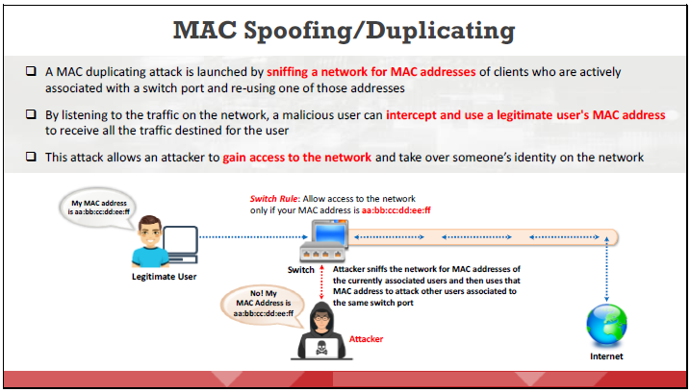
Network Level Attacks and Countermeasures - Sniffing Techniques
MAC duplicating refers to spoofing a MAC address with the MAC address of a legitimate user on the network.
Dr. M Malook Rind Information Security Lecture 10

Slide 15
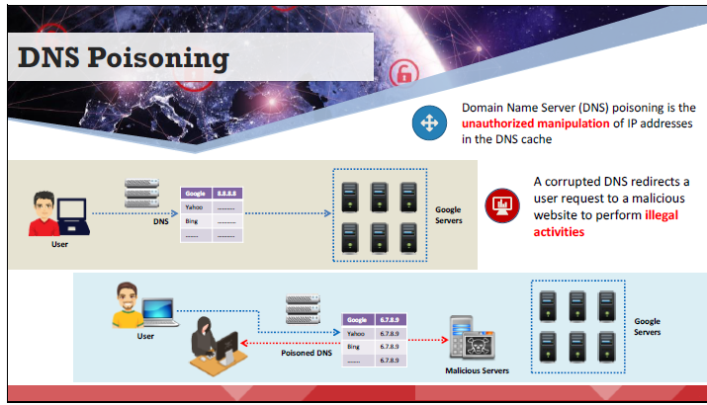
Network Level Attacks and Countermeasures - Sniffing Techniques
DNS is the protocol that translates a domain name (e.g., www.eccouncil.org) into an IP address (e.g., 208.66.172.56).
DNS poisoning, also known as DNS spoofing, the attacker tricks to redirect the victim to a malicious server by manipulating the DNS table entries in the DNS.
Dr. M Malook Rind Information Security Lecture 10

Slide 16
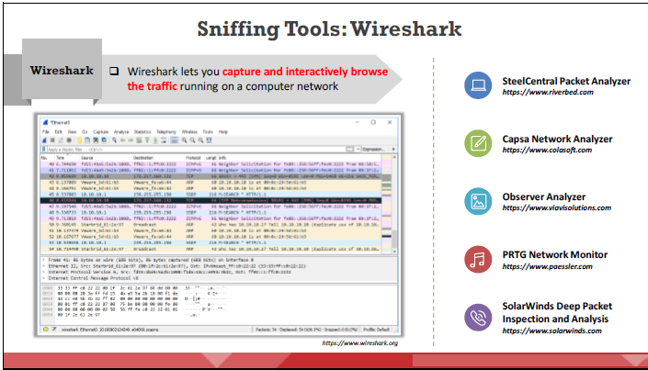
Network Level Attacks and Countermeasures - Sniffing Tools
System administrators use such tools to monitor their network, but attackers misuse these tools to sniff network data.
Wireshark captures live network traffic from Ethernet, IEEE 802.11, PPP/HDLC, ATM, Bluetooth, USB, Token Ring, Frame Relay, and FDDI networks.
Attackers use Wireshark to sniff and analyze the packet flow in the target network and extract critical information.
Dr. M Malook Rind Information Security Lecture 10

Slide 17
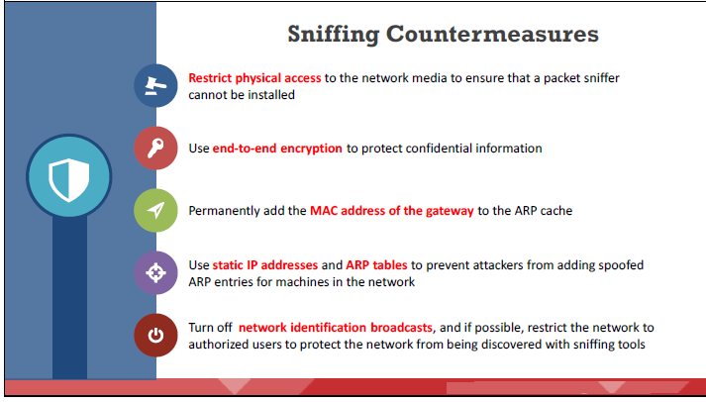
Network Level Attacks and Countermeasures - Sniffing Countermeasures
Some of the countermeasures to be followed to defend against sniffing include:
Dr. M Malook Rind Information Security Lecture 10

Slide 18
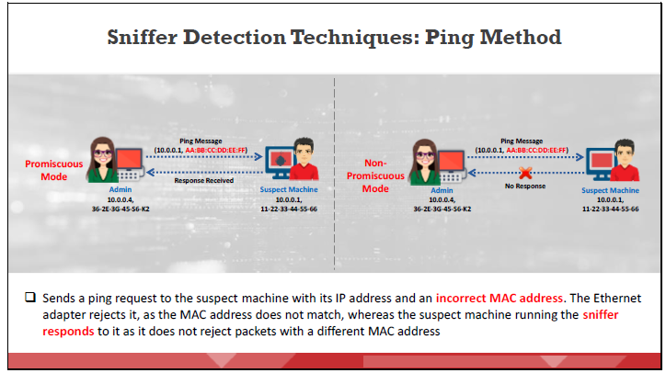
Network Level Attacks and Countermeasures - Sniffing Countermeasures
The ping method is useful in detecting a system that runs in promiscuous mode, which in turn helps to detect sniffers installed on the network
Dr. M Malook Rind Information Security Lecture 10

Slide 19

Network Level Attacks and Countermeasures – Denial-of-Service Attacks
Denial-of-service (DoS) and distributed denial-of-service (DDoS) attacks are a major threat to computer networks.
These attacks attempt to make a machine or network resource unavailable to its authorized users.
Usually, DoS/DDoS attacks exploit vulnerabilities in the implementation of the transmission control protocol (TCP)/internet protocol (IP) model or bugs in a specific operating system (OS).
Dr. M Malook Rind Information Security Lecture 10

Slide 20
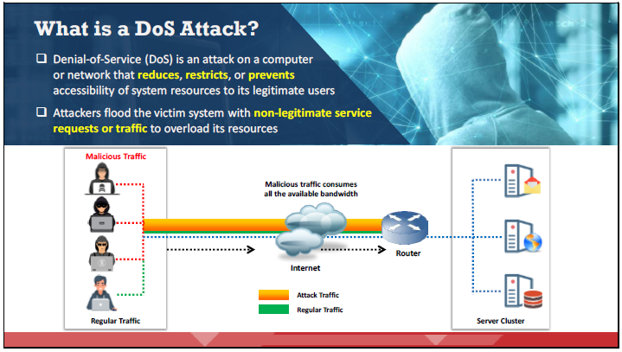
Network Level Attacks and Countermeasures – Denial-of-Service Attacks
The goal of a DoS attack is to keep legitimate users from using the system, rather than to gain unauthorized access to a system or to corrupt data.
DoS attacks have various forms and target various services.
Dr. M Malook Rind Information Security Lecture 10

Slide 21
Network Level Attacks and Countermeasures – Denial-of-Service Attacks
The following are examples for types of DoS attacks:
Flooding the victim’s system with more traffic than it can handle
Flooding a service (e.g., Internet Relay Chat (IRC)) with more events than it can handle
Crashing a TCP/IP stack by sending corrupt packets
Crashing a service by interacting with it in an unexpected manner
Hanging a system by causing it to go into an infinite loop
DoS attacks have various forms and target various services.
Consumption of resources
Consumption of bandwidth, disk space, CPU time, or data structures
Actual physical destruction or alteration of network components
Destruction of programming and files in a computer system
Dr. M Malook Rind Information Security Lecture 10

Slide 22
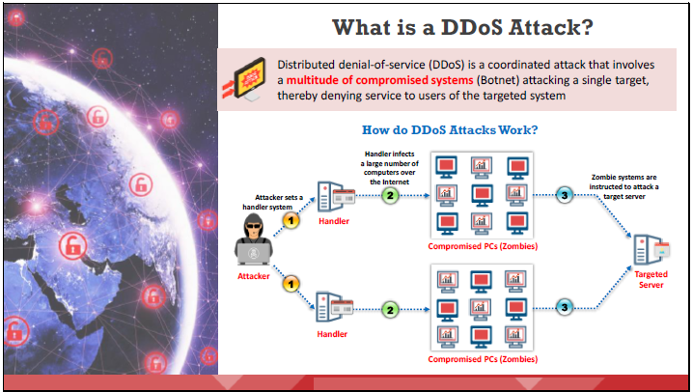
Network Level Attacks and Countermeasures – Denial-of-Service Attacks
Dr. M Malook Rind Information Security Lecture 10

Slide 23
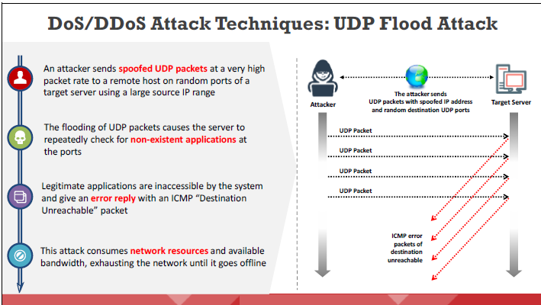
Network Level Attacks and Countermeasures – Denial-of-Service Attacks
Dr. M Malook Rind Information Security Lecture 10

Slide 24
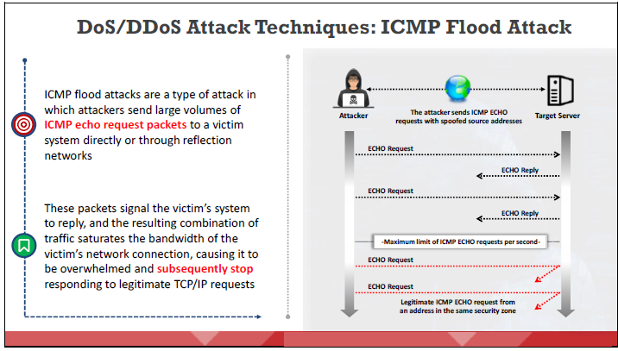
Network Level Attacks and Countermeasures – Denial-of-Service Attacks
Dr. M Malook Rind Information Security Lecture 10

Slide 25
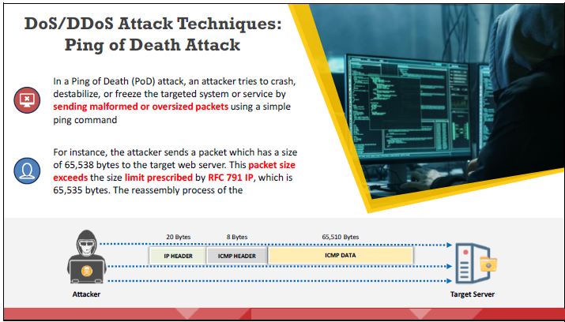
Network Level Attacks and Countermeasures – Denial-of-Service Attacks
Dr. M Malook Rind Information Security Lecture 10

Slide 26
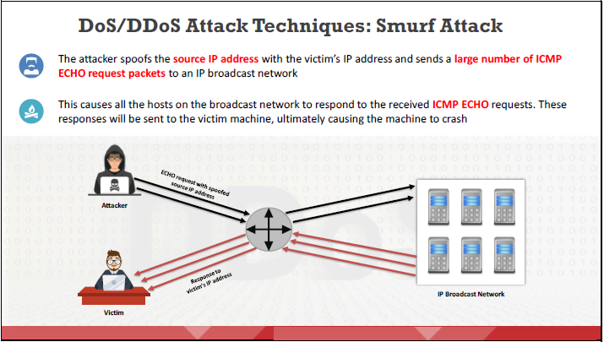
Network Level Attacks and Countermeasures – Denial-of-Service Attacks
Dr. M Malook Rind Information Security Lecture 10

Slide 27
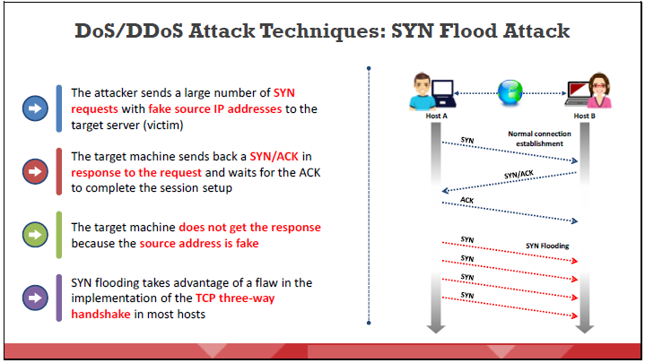
Network Level Attacks and Countermeasures – Denial-of-Service Attacks
Dr. M Malook Rind Information Security Lecture 10

Slide 28
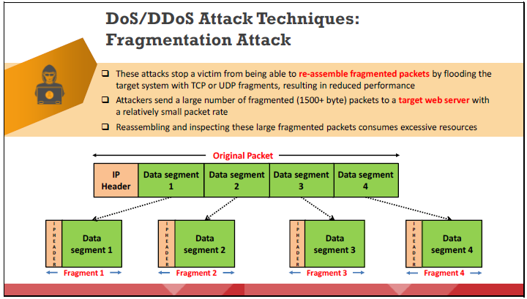
Network Level Attacks and Countermeasures – Denial-of-Service Attacks
Dr. M Malook Rind Information Security Lecture 10

Slide 29
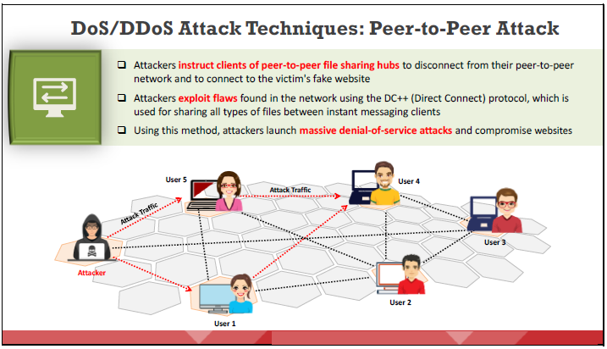
Network Level Attacks and Countermeasures – Denial-of-Service Attacks
Dr. M Malook Rind Information Security Lecture 10

Slide 30
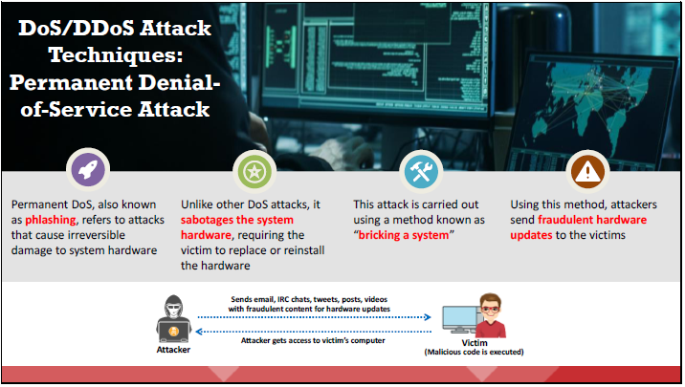
Network Level Attacks and Countermeasures – Denial-of-Service Attacks
This type of attack is quicker and more destructive than conventional DoS attacks. It works with a limited amount of resources, unlike a DDoS attack, in which attackers unleash a set of zombies onto a target.
Dr. M Malook Rind Information Security Lecture 10

Slide 31
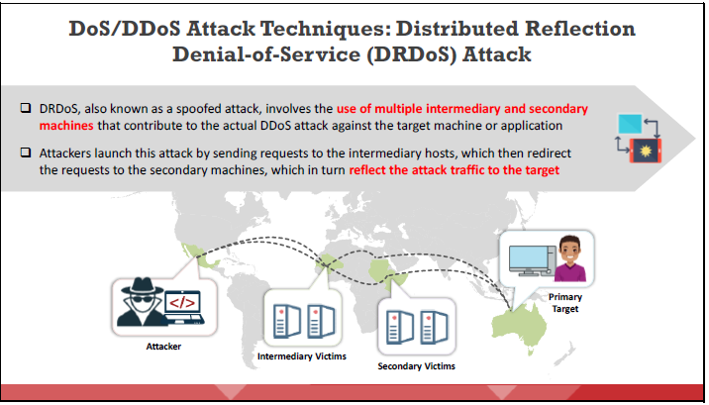
Network Level Attacks and Countermeasures – Denial-of-Service Attacks
This attack involves an attacker machine, intermediary victims (zombies), secondary victims (reflectors), and a target machine
Dr. M Malook Rind Information Security Lecture 10

Slide 32
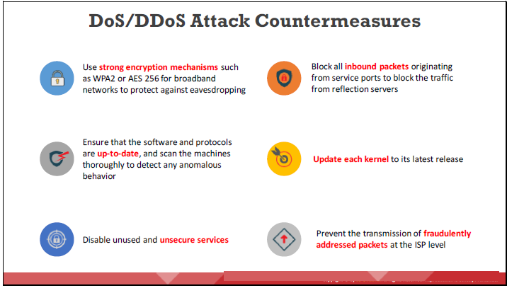
Network Level Attacks and Countermeasures – DoS and DDoS Countermeasures
DoS/DDoS is one of the foremost security threats on the Internet; thus, there is a great necessity for solutions to mitigate these attacks.
Implementing defensive mechanisms at proper places by following proper measures allows the heightening of organizational network security.
Dr. M Malook Rind Information Security Lecture 10

Slide 33
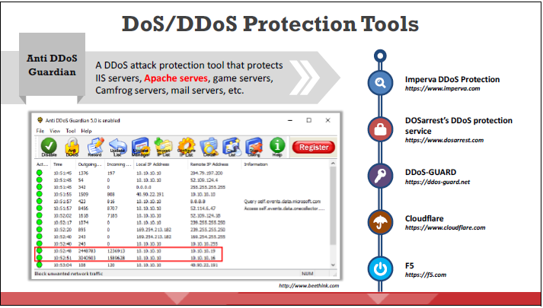
Network Level Attacks and Countermeasures – DoS and DDoS Countermeasures
Dr. M Malook Rind Information Security Lecture 10

Slide 34

Network Level Attacks and Countermeasures – Session Hijacking
Session hijacking allows attackers to take over an active session by bypassing the authentication process.
Thereafter, they can perform any action on the hijacked system.
Dr. M Malook Rind Information Security Lecture 10

Slide 35
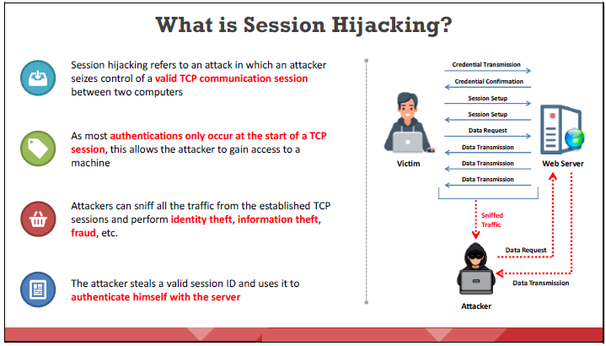
Network Level Attacks and Countermeasures – Session Hijacking
A web server sends a session identification token or key to a web client after successful authentication. These session tokens differentiate multiple sessions that the server establishes with clients.
Dr. M Malook Rind Information Security Lecture 10

Slide 36
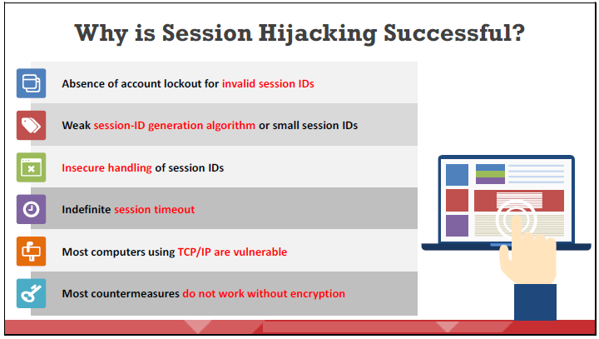
Network Level Attacks and Countermeasures – Session Hijacking
Session hijacking succeeds because of the following factors.
Dr. M Malook Rind Information Security Lecture 10

Slide 37
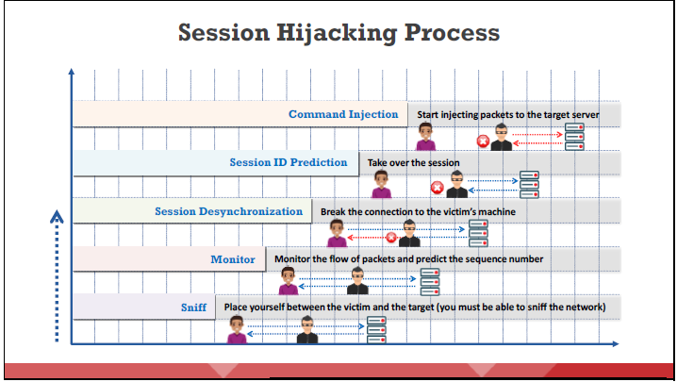
Network Level Attacks and Countermeasures – Session Hijacking
It is easier for an attacker to sneak into a system as a genuine user than to enter a system directly.
After hijacking the session, the attacker can stay connected for hours without arousing suspicion.
During this period, all traffic intended for the user’s IP address goes to the attacker’s system instead, and the attacker can plant backdoors or gain additional access to the system
Dr. M Malook Rind Information Security Lecture 10

Slide 38
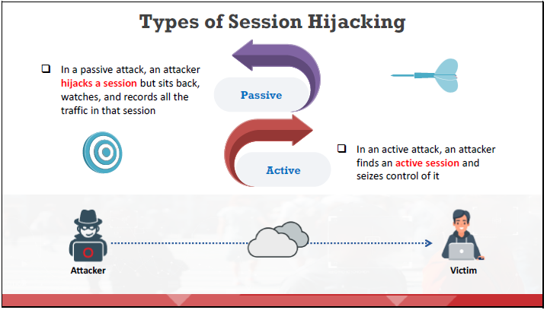
Network Level Attacks and Countermeasures – Session Hijacking
Session hijacking can be either active or passive, depending on the degree of involvement of the attacker.
Dr. M Malook Rind Information Security Lecture 10

Slide 39
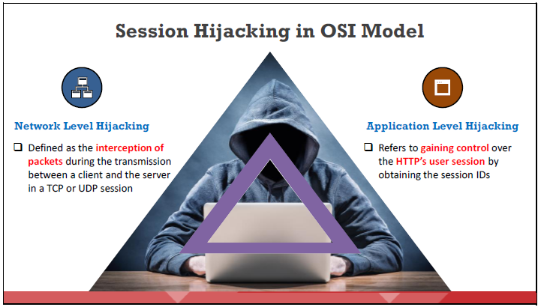
Network Level Attacks and Countermeasures – Session Hijacking
There are two levels of session hijacking in the OSI model:
Dr. M Malook Rind Information Security Lecture 10

Slide 40
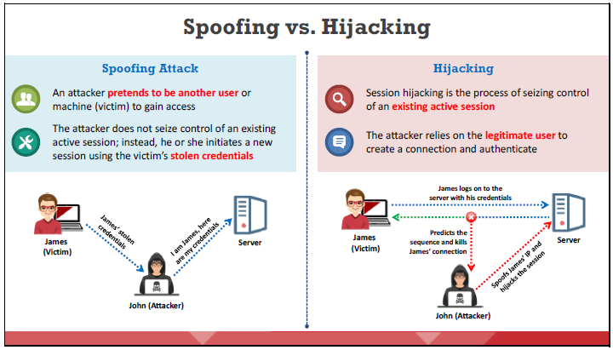
Network Level Attacks and Countermeasures – Session Hijacking
Dr. M Malook Rind Information Security Lecture 10

Slide 41
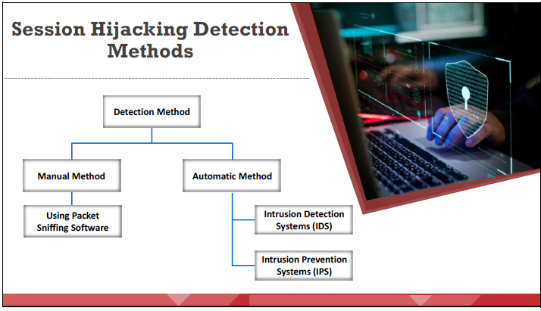
Network Level Attacks and Countermeasures – Session Hijacking Countermeasures
Hijacking is a dangerous attack because the victim is at risk of identity theft, fraud, and loss of sensitive information. All networks using TCP/IP are vulnerable to the different types of session hijacking attacks. However, following best practices might protect against session hijacking attacks.
Dr. M Malook Rind Information Security Lecture 10

Slide 42
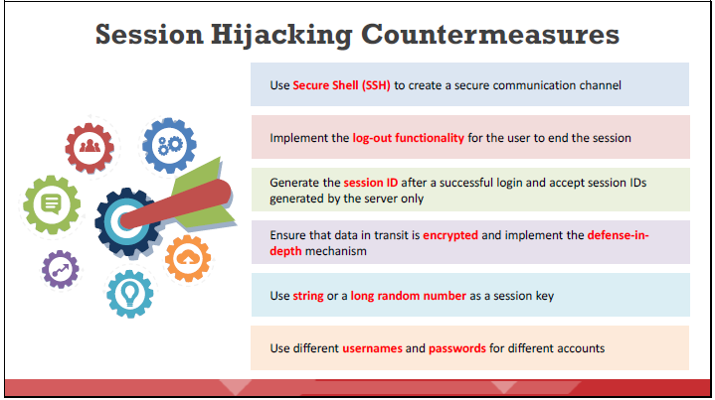
Network Level Attacks and Countermeasures – Session Hijacking Countermeasures
Below are some of the countermeasures to be followed to defend against session hijacking
Dr. M Malook Rind Information Security Lecture 10

Slide 43
Thanks
Dr. M Malook Rind Information Security Lecture 10

